Slide 1



Hash Tables
This Chapter discusses several ways of storing information in an array, and later searching for the information.
Hash tables are a common approach to the storing/searching problem.
This presentation introduces hash tables.
Data Structures
and Other Objects
Using C++
Notes:
This lecture illustrates hash tables, using open addressing.
Before this lecture, students should have seen other forms of a Dictionary, where a collection of data is stored, and each data item has a key associated with it.

Slide 2
What is a Hash Table ?
The simplest kind of hash table is an array of records.
This example has 701 records.
[ 0 ]
[ 1 ]
[ 2 ]
[ 3 ]
[ 4 ]
[ 5 ]
[ 700]
. . .
An array of records
Notes:
This lecture introduces hash tables, which are an array-based method for implementing a Dictionary. You should recall that we have seen dictionaries implemented in other ways, for example with a binary search tree. The abstract properties of a dictionary remain the same: We can insert items in the dictionary, and each item has a key associated with it. When we want to retrieve an item, we specify only the key, and the retrieval process finds the associated data.
What we do now is use an array to implement the dictionary. The array is an array of records. In this example, we could store up to 701 records in the array.

Slide 3
What is a Hash Table ?
[ 4 ]
Number 506643548
Each record has a special field, called its key.
In this example, the key is a long integer field called Number.
[ 0 ]
[ 1 ]
[ 2 ]
[ 3 ]
[ 4 ]
[ 5 ]
[ 700]
. . .
Notes:
Each record in the array contains two parts. The first part is a number that we'll use for the key of the item. We could use something else for the keys, such as a string. But for a hash table, numbers make the most convenient keys.

Slide 4

What is a Hash Table ?
[ 4 ]
Number 506643548
The number might be a person's identification number, and the rest of the record has information about the person.
[ 0 ]
[ 1 ]
[ 2 ]
[ 3 ]
[ 4 ]
[ 5 ]
[ 700]
. . .
Notes:
The numbers might be identification numbers of some sort, and the rest of the record contains information about a person. So the pattern that you see here is the same pattern that you've seen in other dictionaries: Each entry in the dictionary has a key (in this case an identifying number) and some associated data.

Slide 5



What is a Hash Table ?
When a hash table is in use, some spots contain valid records, and other spots are "empty".
[ 0 ]
[ 1 ]
[ 2 ]
[ 3 ]
[ 4 ]
[ 5 ]
[ 700]
Number 281942902
Number 233667136
Number 506643548
. . .
Number 155778322
Notes:
When a hash table is being used as a dictionary, some of the array locations are in use, and other spots are "empty", waiting for a new entry to come along.
Oftentimes, the empty spots are identified by a special key. For example, if all our identification numbers are positive, then we could use 0 as the Number that indicates an empty spot.
With this drawing, locations [0], [4], [6], and maybe some others would all have Number=0.

Slide 6
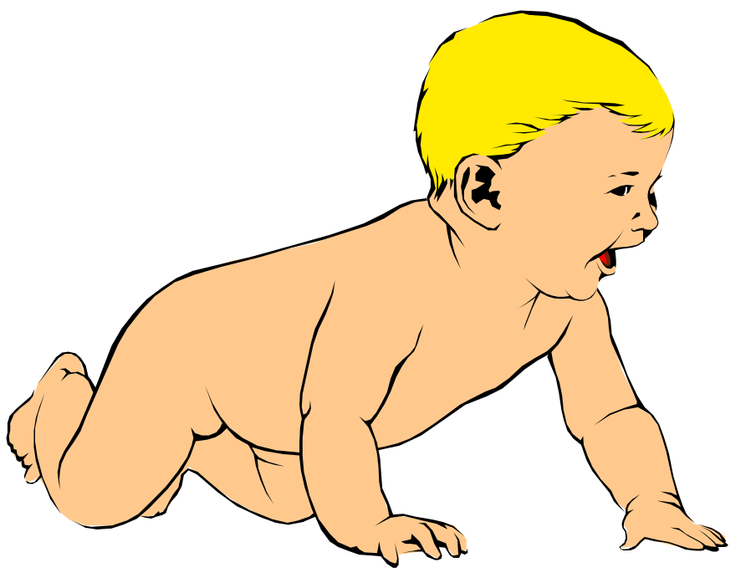
Inserting a New Record
Number 580625685
In order to insert a new record, the key must somehow be converted to an array index.
The index is called the hash value of the key.
[ 0 ]
[ 1 ]
[ 2 ]
[ 3 ]
[ 4 ]
[ 5 ]
[ 700]
Number 281942902
Number 233667136
Number 506643548
. . .
Number 155778322
Notes:
In order to insert a new entry, the key of the entry must somehow be converted to an index in the array. For our example, we must convert the key number into an index between 0 and 700. The conversion process is called hashing and the index is called the hash value of the key.

Slide 7
Inserting a New Record
Number 580625685
Typical way create a hash value:
(Number mod 701)
What is (580625685 mod 701) ?
[ 0 ]
[ 1 ]
[ 2 ]
[ 3 ]
[ 4 ]
[ 5 ]
[ 700]
Number 281942902
Number 233667136
Number 506643548
. . .
Number 155778322
Notes:
There are many ways to create hash values. Here is a typical approach.
a. Take the key mod 701 (which could be anywhere from 0 to 700).
So, quick, what is (580,625,685 mod 701) ?

Slide 8
Inserting a New Record
Number 580625685
Typical way to create a hash value:
(Number mod 701)
3
What is (580625685 mod 701) ?
[ 0 ]
[ 1 ]
[ 2 ]
[ 3 ]
[ 4 ]
[ 5 ]
[ 700]
Number 281942902
Number 233667136
Number 506643548
. . .
Number 155778322
Notes:
Three.

Slide 9
Inserting a New Record
Number 580625685
The hash value is used for the location of the new record.
[3]
[ 0 ]
[ 1 ]
[ 2 ]
[ 3 ]
[ 4 ]
[ 5 ]
[ 700]
Number 281942902
Number 233667136
Number 506643548
. . .
Number 155778322
Notes:
So, this new item will be placed at location [3] of the array.

Slide 10
Inserting a New Record
The hash value is used for the location of the new record.
[ 0 ]
[ 1 ]
[ 2 ]
[ 3 ]
[ 4 ]
[ 5 ]
[ 700]
Number 281942902
Number 233667136
Number 580625685
Number 506643548
. . .
Number 155778322
Notes:
The hash value is always used to find the location for the record.

Slide 11

Collisions
Number 701466868
Here is another new record to insert, with a hash value of 2.
My hash
value is [2].
[ 0 ]
[ 1 ]
[ 2 ]
[ 3 ]
[ 4 ]
[ 5 ]
[ 700]
Number 281942902
Number 233667136
Number 580625685
Number 506643548
. . .
Number 155778322
Notes:
Sometimes, two different records might end up with the same hash value.

Slide 12

Collisions
Number 701466868
This is called a collision, because there is already another valid record at [2].
When a collision occurs,
move forward until you
find an empty spot.
[ 0 ]
[ 1 ]
[ 2 ]
[ 3 ]
[ 4 ]
[ 5 ]
[ 700]
Number 281942902
Number 233667136
Number 580625685
Number 506643548
. . .
Number 155778322
Notes:
This is called a collision.
When a collision occurs, the insertion process will move forward through the array until an empty spot is found. Sometimes you will have a second collision...

Slide 13
Collisions
Number 701466868
This is called a collision, because there is already another valid record at [2].
When a collision occurs,
move forward until you
find an empty spot.
[ 0 ]
[ 1 ]
[ 2 ]
[ 3 ]
[ 4 ]
[ 5 ]
[ 700]
Number 281942902
Number 233667136
Number 580625685
Number 506643548
. . .
Number 155778322
Notes:
...and a third collision...

Slide 14
Collisions
Number 701466868
This is called a collision, because there is already another valid record at [2].
When a collision occurs,
move forward until you
find an empty spot.
[ 0 ]
[ 1 ]
[ 2 ]
[ 3 ]
[ 4 ]
[ 5 ]
[ 700]
Number 281942902
Number 233667136
Number 580625685
Number 506643548
. . .
Number 155778322
Notes:
But if there are any empty spots, eventually you will reach an empty spot, and the new item is inserted here.

Slide 15
Collisions
This is called a collision, because there is already another valid record at [2].
The new record goes
in the empty spot.
[ 0 ]
[ 1 ]
[ 2 ]
[ 3 ]
[ 4 ]
[ 5 ]
[ 700]
Number 281942902
Number 233667136
Number 580625685
Number 506643548
Number 701466868
. . .
Number 155778322
Notes:
The new record is always placed in the first available empty spot, after the hash value.

Slide 16

A Quiz
Where would you be placed in this table, if there is no collision? Use your social security number or some other favorite number.
[ 0 ]
[ 1 ]
[ 2 ]
[ 3 ]
[ 4 ]
[ 5 ]
[ 700]
Number 281942902
Number 233667136
Number 580625685
Number 506643548
Number 701466868
. . .
Number 155778322
Notes:
Time for another quiz . . . Did anyone end up with a hash value of 700?
Well, I did. My ID number is 155779023, which has a hash value of 700. (No, not really, but I needed to illustrate another kind of collision.
There is a collision with the last location of the array. In this case, you would circle back to the start of the array, and try location number 0, then 1, .... until you find an empty spot. In this example, I would be inserted at location 0, since that location is empty.

Slide 17
Searching for a Key
Number 701466868
The data that's attached to a key can be found fairly quickly.
[ 0 ]
[ 1 ]
[ 2 ]
[ 3 ]
[ 4 ]
[ 5 ]
[ 700]
Number 281942902
Number 233667136
Number 580625685
Number 506643548
Number 701466868
. . .
Number 155778322
Notes:
It is fairly easy to search for a particular item based on its key.

Slide 18
Searching for a Key
Number 701466868
Calculate the hash value.
Check that location of the array for the key.
My hash
value is [2].
Not me.
[ 0 ]
[ 1 ]
[ 2 ]
[ 3 ]
[ 4 ]
[ 5 ]
[ 700]
Number 281942902
Number 233667136
Number 580625685
Number 506643548
Number 701466868
. . .
Number 155778322
Notes:
Start by computing the hash value, which is 2 in this case. Then check location 2. If location 2 has a different key than the one you are looking for, then move forward...

Slide 19
Searching for a Key
Number 701466868
Keep moving forward until you find the key, or you reach an empty spot.
My hash
value is [2].
Not me.
[ 0 ]
[ 1 ]
[ 2 ]
[ 3 ]
[ 4 ]
[ 5 ]
[ 700]
Number 281942902
Number 233667136
Number 580625685
Number 506643548
Number 701466868
. . .
Number 155778322
Notes:
...if the next location is not the one we are looking for, then keep moving forward...

Slide 20
Searching for a Key
Number 701466868
Keep moving forward until you find the key, or you reach an empty spot.
My hash
value is [2].
Not me.
[ 0 ]
[ 1 ]
[ 2 ]
[ 3 ]
[ 4 ]
[ 5 ]
[ 700]
Number 281942902
Number 233667136
Number 580625685
Number 506643548
Number 701466868
. . .
Number 155778322
Notes:
Keep moving forward until you find the sought-after key...

Slide 21
Searching for a Key
Number 701466868
Keep moving forward until you find the key, or you reach an empty spot.
My hash
value is [2].
Yes!
[ 0 ]
[ 1 ]
[ 2 ]
[ 3 ]
[ 4 ]
[ 5 ]
[ 700]
Number 281942902
Number 233667136
Number 580625685
Number 506643548
Number 701466868
. . .
Number 155778322
Notes:
In this case we find the key at location [5].

Slide 22
Searching for a Key
Number 701466868
When the item is found, the information can be copied to the necessary location.
My hash
value is [2].
Yes!
[ 0 ]
[ 1 ]
[ 2 ]
[ 3 ]
[ 4 ]
[ 5 ]
[ 700]
Number 281942902
Number 233667136
Number 580625685
Number 506643548
Number 701466868
. . .
Number 155778322
Notes:
The data from location [5] can then be copied to to provide the result of the search function.
What happens if a search reaches an empty spot? In that case, it can
halt and indicate that the key was not in the hash table.

Slide 23
Deleting a Record
Records may also be deleted from a hash table.
Please
delete me.
[ 0 ]
[ 1 ]
[ 2 ]
[ 3 ]
[ 4 ]
[ 5 ]
[ 700]
Number 281942902
Number 233667136
Number 580625685
Number 506643548
Number 701466868
. . .
Number 155778322
Notes:
Records can be deleted from a hash table...

Slide 24
Deleting a Record
Records may also be deleted from a hash table.
But the location must not be left as an ordinary "empty spot" since that could interfere with searches.
[ 0 ]
[ 1 ]
[ 2 ]
[ 3 ]
[ 4 ]
[ 5 ]
[ 700]
Number 281942902
Number 233667136
Number 580625685
Number 701466868
. . .
Number 155778322
Notes:
But the spot of the deleted record cannot be left as an ordinary empty spot, since that would interfere with searches. (Remember that a search can stop when it reaches an empty spot.)

Slide 25
Deleting a Record
Records may also be deleted from a hash table.
But the location must not be left as an ordinary "empty spot" since that could interfere with searches.
The location must be marked in some special way so that a search can tell that the spot used to have something in it.
[ 0 ]
[ 1 ]
[ 2 ]
[ 3 ]
[ 4 ]
[ 5 ]
[ 700]
Number 281942902
Number 233667136
Number 580625685
Number 701466868
. . .
Number 155778322
Notes:
Instead we must somehow mark the location as "a location that used to have something here, but no longer does."
We might do this by using some other special value for the Number field of the record.
In any case, a search can not stop when it reaches "a location that used to have something here". A search can only stop when it reaches a true empty spot.

Slide 26
Summary
Hash tables store a collection of records with keys.
The location of a record depends on the hash value of the record's key.
When a collision occurs, the next available location is used.
Searching for a particular key is generally quick.
When an item is deleted, the location must be marked in a special way, so that the searches know that the spot used to be used.
Notes:
A quick summary . . .

Slide 27
Implementing Dynamic Dictionaries
Want a data structure in which finds/searches are very fast
  As close to O(1) as possible
  minimum number of executed instructions per method
Insert and Deletes should be fast too
Objects in dictionary have unique keys
  A key may be a single property/attribute value
  Or may be created from multiple properties/values

Slide 28
Hash tables vs. Other Data Structures
We want to implement the dictionary operations Insert(), Delete() and Search()/Find() efficiently.
Arrays:
  can accomplish in O(1) time
  but are not space efficient (assumes we leave empty space for keys not currently in dictionary)
Binary search trees
  can accomplish in O(log n) time
  are space efficient.
Hash Tables:
  A generalization of an array that under some reasonable assumptions is O(1) for Insert/Delete/Search of a key

Slide 29
Array Approach – example
A social security application keeping track of people where the primary search key is a person’s social security number (SSN)
You can use an array to hold references to all the person objects
  Use an array with range 0 - 999,999,999
  Using the SSN as a key, you have O(1) access to any person object
Unfortunately, the number of active keys (Social Security Numbers) is much less than the array size (1 billion entries)
  Est. US population, Oct. 20th 2004: 294,564,209
  Over 60% of the array would be unused

Slide 30
Hash Tables
Very useful data structure
  Good for storing and retrieving key-value pairs
  Not good for iterating through a list of items
Example applications:
  Storing objects according to ID numbers
    When the ID numbers are widely spread out
    When you don’t need to access items in ID order

Slide 31
Hash Tables – Conceptual View
buckets
table
obj1
key=15
7
6
5
4
3
2
1
0
Obj3
key=4
Obj2
key=30
hash value/index
Obj4
key=2
Obj5
key=1

Slide 32
Hash Tables
Hash Tables solve these problems by using a much smaller array and mapping keys with a hash function.
Let universe of keys U and an array of size m. A hash function h is a function from U to 0…m, that is:
h : U 0…m
0
1
2
3
4
5
6
7
U
k₁ k₂
k₃ k₄
k₆
h (k₂)=2
h (k₁)=h (k₃)=3
h (k₆)=5
h (k₄)=7
(universe of keys)

Slide 33
Hash index/value
A hash value or hash index is used to index the hash table (array)
A hash function takes a key and returns a hash value/index
  The hash index is a integer (to index an array)
The key is specific value associated with a specific object being stored in the hash table
  It is important that the key remain constant for the lifetime of the object

Slide 34
Hash Function
You want a hash function/algorithm that is:
  Fast
  Creates a good distribution of hash values so that the items (based on their keys) are distributed evenly through the array
Hash functions can use as input
  Integer key values
  String key values
  Multipart key values
    Multipart fields, and/or
    Multiple fields

Slide 35
The mod function
Stands for modulo
When you divide x by y, you get a result and a remainder
Mod is the remainder
  8 mod 5 = 3
  9 mod 5 = 4
  10 mod 5 = 0
  15 mod 5 = 0
Thus for key-value mod M, multiples of M give the same result, 0
  But multiples of other numbers do not give the same result
  So what happens when M is a prime number where the keys are not multiples of M?

Slide 36
Hash Tables: Insert Example
For example, if we hash keys 0…1000 into a hash table with 5 entries and use h(key) = key mod 5 , we get the following sequence of events:
Insert 2
Insert 21
Insert 34
Insert 54
key data
key data
key data
0
1
2
3
4
0
1
2
3
4
0
1
2
3
4
21 …
21 …
There is a
collision at
array entry #4
2 …
2 …
2 …
34 …
???

Slide 37
Dealing with Collisions
A problem arises when we have two keys that hash in the same array entry – this is called a collision.
There are two ways to resolve collision:
  Hashing with Chaining (a.k.a. “Separate Chaining”): every hash table entry contains a pointer to a linked list of keys that hash in the same entry
  Hashing with Open Addressing: every hash table entry contains only one key. If a new key hashes to a table entry which is filled, systematically examine other table entries until you find one empty entry to place the new key

Slide 38
Hashing with Chaining
The problem is that keys 34 and 54 hash in the same entry (4). We
solve this collision by placing all keys that hash in the same hash table
entry in a chain (linked list) or bucket (array) pointed by this entry:
Insert 54
other
key key data
Insert 101
0
1
2
3
4
0
1
2
3
4
21
21
101
2
2
54
34
54
34
CHAIN

Slide 39
Hashing with Chaining
What is the running time to insert/search/delete?
  Insert: It takes O(1) time to compute the hash function and insert at head of linked list
  Search: It is proportional to max linked list length
  Delete: Same as search
Therefore, in the unfortunate event that we have a “bad” hash function all n keys may hash in the same table entry giving an O(n) run-time!
So how can we create a “good” hash function?

Slide 40
Choosing a Hash Function – 1
The performance of the hash table depends on having a hash function that evenly distributes the keys: uniform hashing is the ideal target
Choosing a good hash function requires taking into account the kind of data that will be used.
  The statistics of the key distribution needs to be accounted for
  E.g., Choosing the first letter of a last name will likely cause lots of collisions depending on the nationality of the population
Most programming languages have hash functions built in

Slide 41
Choosing a Hash Function – 2
Division/modulo method
  key mod m
  m is the array size; in general, it should be prime number
Multiplication method
  Floor ((key*someFraction mod 1)*arraySize)
  Where some fraction is typically 0.618

Slide 42
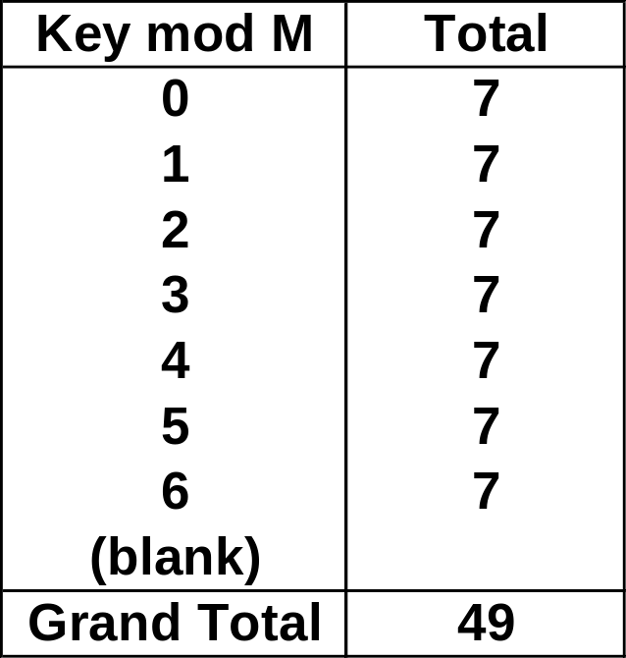
Prime Number Distribution
For example, assume
Keys (key values) are multiples of 5
  5, 10, 15, 20, 25…
The keys are evenly distributed 5 to 245
An M (the divisor) of 7
Then, the hash values will be evenly distributed from 0 to 6 for the keys
  See table →
If M was 5, then you would have what kind of distribution?
hash value = key mod m
(m is typically the table size)

Slide 43
Choosing Hash Function – 3
If keys are non-random – e.g. part numbers
  Use all data to contribute to the hash function to get a better distribution
  Consider folding – sum the natural (or arbitrary) groups of digits in key
  Don’t use redundant or non-data (.e.g. checksum values)
  Do not use information that might change!
➔ Analyze your expected key values (or some representative subset) to make sure your hash function gives a good distribution!

Slide 44
Hash Tables – Open Addressing
table
obj1
key=15
7
6
5
4
3
2
1
0
Obj3
key=4
Index=4
Obj2
key=30
hash value/index
Index=4
Obj4
key=2
Obj5
key=1

Slide 45
Hashing with Open Addressing
So far we have studies hashing with chaining, using a list to store the items that hash to the same location
Another option is to store all the items (references to single items) directly in the table.
Open addressing
  collisions are resolved by systematically examining other table indexes, i₀ , i₁ , i₂ , … until an empty slot is located.

Slide 46
Open Addressing
The key is first mapped to an array cell using the hash function (e.g. key % array-size)
If there is a collision find an available array cell
There are different algorithms to find (to probe for) the next array cell
  Linear
  Quadratic
  Double Hashing

Slide 47
Probe Algorithms (Collision Resolution)
Linear Probing
  Choose the next available array cell
    First try arrayIndex = hash value + 1
    Then try arrayIndex = hash value + 2
    Be sure to wrap around the end of the array!
    arrayIndex = (arrayIndex + 1) % arraySize
    Stop when you have tried all possible array indices
  If the array is full, you need to throw an exception or, better yet, resize the array
Quadratic Probing
  Variation of linear probing that uses a more complex function to calculate the next cell to try

Slide 48
Double Hashing
Apply a second hash function after the first
The second hash function, like the first, is dependent on the key
Secondary hash function must
  Be different than the first
  And, obviously, not generate a zero
Good algorithm:
  arrayIndex = (arrayIndex + stepSize) % arraySize;
  Where stepSize = constant – (key % constant)
  And constant is a prime less than the array size

Slide 49
Load Factor
Understanding the expected load factor will help you determine the efficiency of you hash table implementation and hash functions
Load factor = number of items in hash table / array size
For Open Addressing:
  If < 0.5, wasting space
  If > 0.8, overflows significant
For Chaining:
  If < 1.0, wasting space
  If > 2.0, then search time to find a specific item may factor in significantly to the [relative] performance

Slide 50
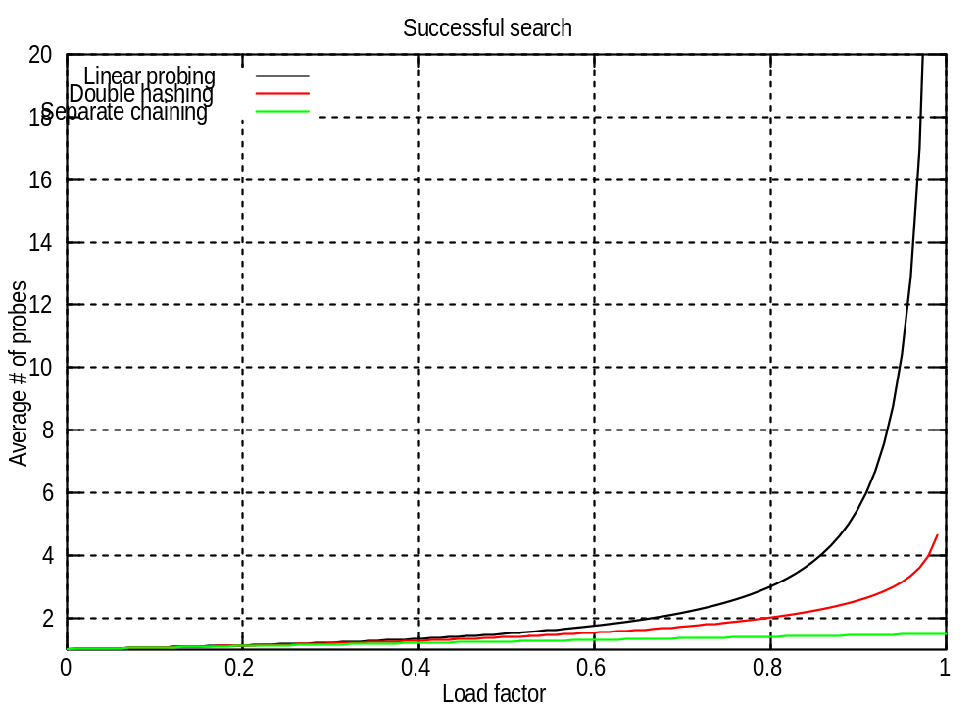

Slide 51
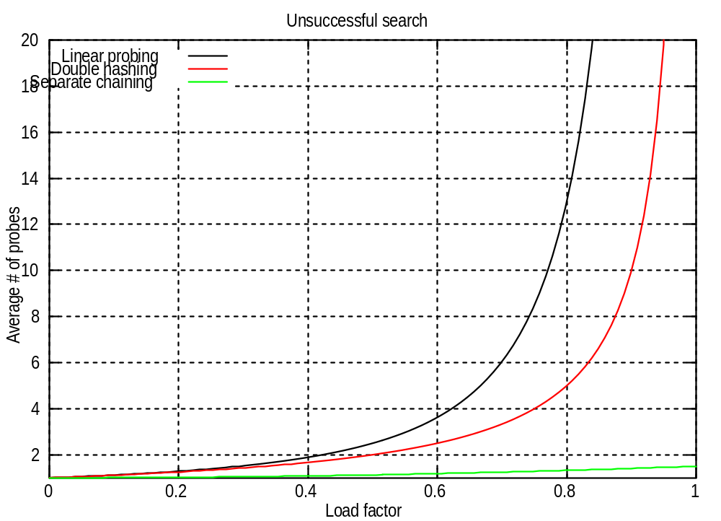

Slide 52
Open Addressing vs. Separate Chaining
When should you be concerned about Open Addressing and Separate Chaining implementations?
Note that there are Hash libraries… Java supports Hashtable, HashMap, LinkedHashMap, HashSet,…
But, if you are implementing your own hash table consider:
  Do you know the total number of items to be inserted into the table?
  Do you have plenty of memory?
  Do you know the expected load factor?

